Slide 1

Capstone Presentation
THE SYNTAX SINNERS

Slide 2




The Team.
The crew that made the problem a reality.
Jeet Daiya
Raj Makavanna
Dhruv Gohil
Neel Shah
202301017
20231183
202301110
202301093
NaughtyCoder1
NaughtyCoder2
NaughtyCoder3
NaughtyCoder4

Slide 3
Abstract
This Presentation discusses the algorithm and analysis of the P3 assigned to us.
In this Presentation, we have discussed two versions of the problem we implemented with some different features and conditions or assumptions.

Slide 4
Introduction
Problem Statement
This section contains problem statement.
Algorithm
This sections gives a brief about both versions, followed by the diagram of Algorithm.
Time and Space Analysis
Time and Space Analysis of both versions are discussed here.
Video
Video with voiceover of code running is shown here.

Slide 5

SECTION-1
PROBLEM STATEMENT

Slide 6
Problem: [P3]
Entry Queue Manager
You need to build an entry queue manager for a stadium. There are N entry gates. As people keep coming in, they can line up in any of the queues or switch queues anytime if they think that will get them a quicker entry. The entry queue manager helps them in making that decision by suggesting:(i) the waiting time for the last person in the queue to enter through any gate (assume that it takes p mins for a single attendee to enter any gate), (ii) the particular queue number(s) where one should be switching. The queue manager must be designed to minimize the time it takes for M people to enter the stadium. Each gate has an initial random 2assignment of M/2 people (a gate may not have anyone assigned).
“Initial random assignment of M/2 people”: Half of the total number of attendees (i.e., the capacity of the stadium) are already assigned to each of the gates randomly (may not be equally distributed).

Slide 7

SECTION-2
Algorithm

Slide 8
A Brief About Version-1
This version uses array of structures.
The processing time per person is alloted randomly to each gate.
As per the question random assignment of the first half of the people is done. That is done randomly by the person handlling the manager.
Increment and decreament happen concurrently with the time passing.
After which, based on general consensus at the queue, the switching is done.
If the majority agrees to switch based on the criteria in the switching algorithm, switching occurs.
The switching function used in the code has different sets of conditions depending on which switching is done by the code itself.
Time is updated after each increment and decrement.
The code continues running until all gates are empty.

Slide 9
Some Assumptions of Version-1
Output assumes a person manages the software.
Majority consensus, not individual consent, drives gate switching to mimic real-time decisions.
Processing time per person varies randomly within a range for realism.
People enter gates randomly over time and at random gates.
Delays simulate server refresh/lag in displaying updates.

Slide 10
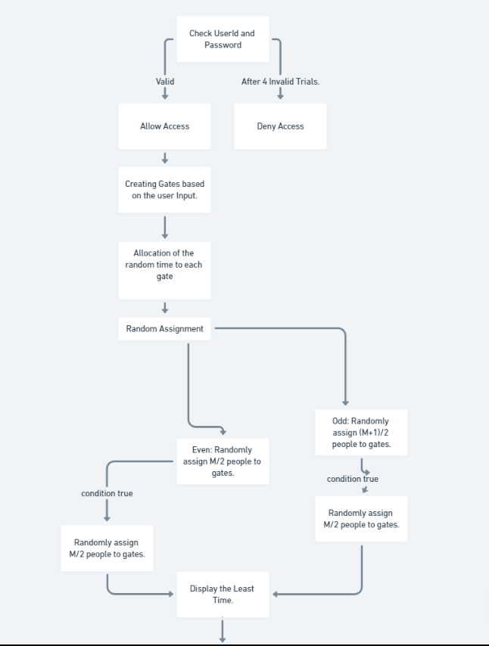
VERSION-1

Slide 11
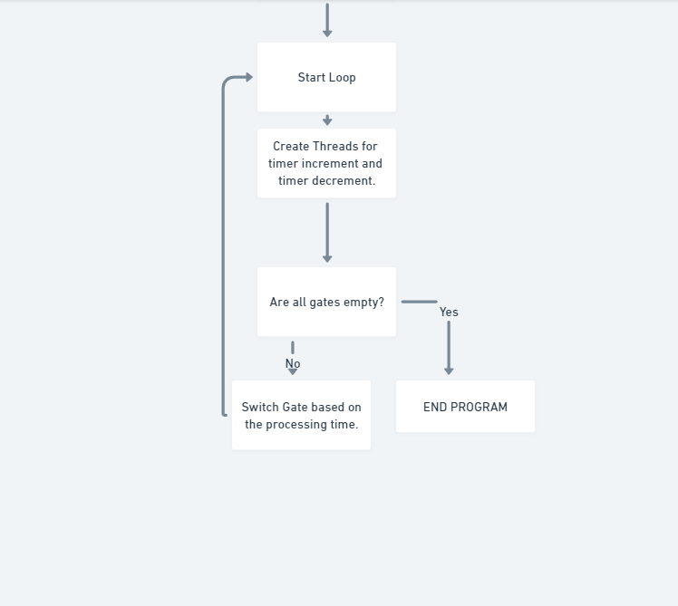
VERSION-1

Slide 12
A Brief About Version-2
This version uses array of class data structures.
The processing time per person is alloted randomly to each gate.
As per the question random assignment of the first half of the people is done. That is done randomly by the person handlling the manager.
Queue manager will suggest people at the end of queue if:
The Queue they are in is not the shortest.
The difference between the queue in which switching is to be done and the shortest queue is significant.
There are 5 or fewer people more than the suggested number willing to switch.
For switching, they are transffered to the shortest Queue.
The code executes till the total processing times of the gate are not nearly same

Slide 13
Some Assumptions of Version-2
The code assumes a person manages the software, expecting valid inputs.
Switching gates is based on majority agreement without individual consent.
Consent is assumed to be communicated to the handler.
The code ignores people already present at gates reducing as they enter.
Switching suggestions continue until all people are in gates with no significant time difference.
Maximum capacity is set at 10,000, adjustable if needed.

Slide 14
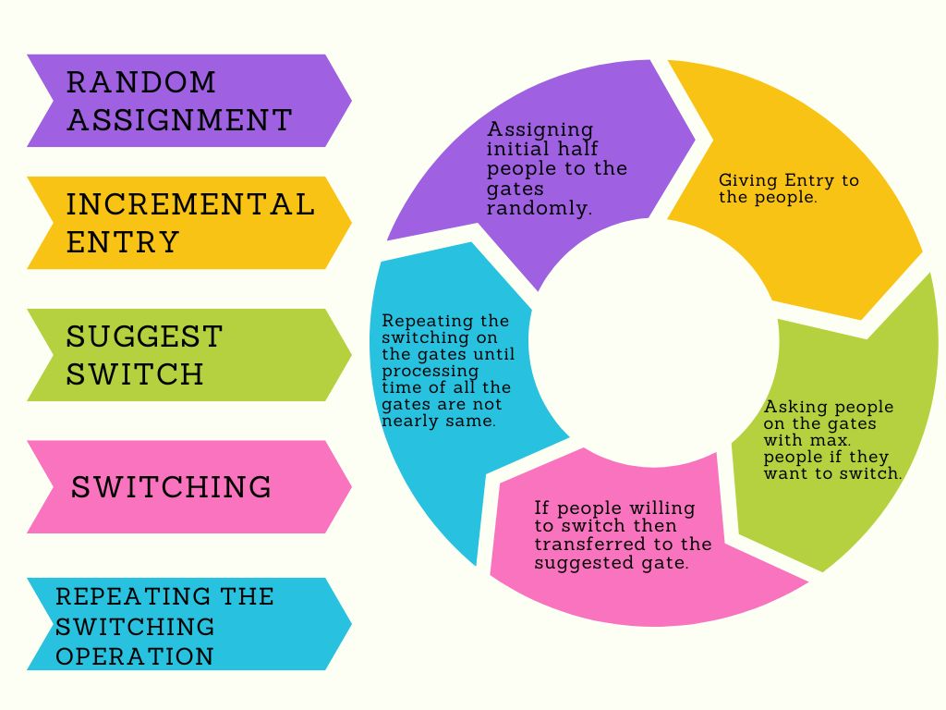
VERSION-2

Slide 15

SECTION-3
Time and Space Analysis

Slide 16
Version-1
Constant Time Complexity (O(1)):
getRandomNumber
updateTotalTime
timerIncrement
switchGate
checkPassword
Linear Time Complexity (O(N)):
randomAssign
allocateTimedecrement
timerDecrement
allZero,
getMinIndex
getMaxIndex
displayLeastTime
NET TIME COMPLEXITY : O(N)
AUXILLARY SPACE COMPLEXITY : O(1)

Slide 17
Version-2
Constant Time Complexity (O(1)):
getRandomNumber
EntryTimeCalc
switching
Increment
Linear Time Complexity (O(N)):
Random_Assign
getMinIndex
getMaxIndex
suggestSwitch
EntryManager can have time complexity O(N*M) in worst case.
NET TIME COMPLEXITY : O(N*M)
AUXILLARY SPACE COMPLEXITY : O(1)

Slide 18

SECTION-4
Video

Slide 19
VERSION-1
https://youtu.be/oTcgazQXYUA

Slide 20
VERSION-2
https://youtu.be/ijzCfdyYzhg

Slide 21
THANK YOU!!
Special Thanks to Sourish Dasgupta Sir.

